Slide 1

Digital Marketing Final Project

Slide 2
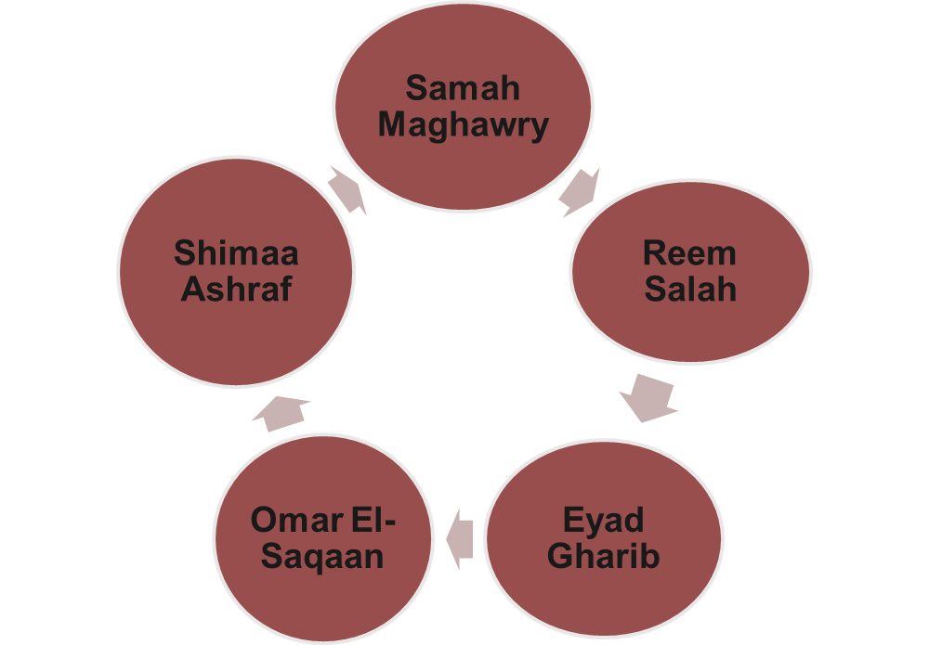


Slide 3
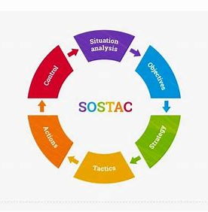
Sostac Model

Slide 4
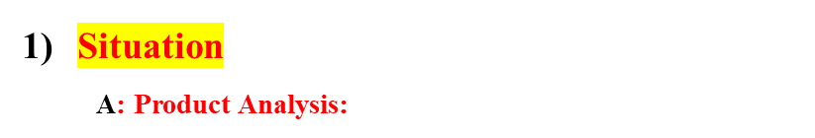
 | Feature | Advantage | Benefit
Nourishment Systems | انظمه تغذية للنحافة | الوصول للوزن المناسب | صحه وثقه ووزت احسن
 | انظمه تغذية للسمنه | الوصول للوزن المناسب | التخلص من الجوع العاطفى
 | انظمه تغذية لمرضى حساسية الطعام | تنوع اطعمه امن واكلات مناسبة | التخلص من متاعب حساسية الطعام
Training Systems | أنظمة رياضية متنوعة | انظمه متخصصه بناءا على الاحتياجات الفردية | ثقه والوصول للهدف والحصول على جسم صحى
 | الاكلات المصاحبة للتمارين قبل وبعد التمرين | حصول على مصادر طاقة وبناء العضلات | الحصول على أداء افضل
 | انظمه تمارين لتجنب الاصابات | الوصول للهدف بشكل اسرع وبدون مخاطر | الحفاظ على الجسم والعضلات

Slide 5
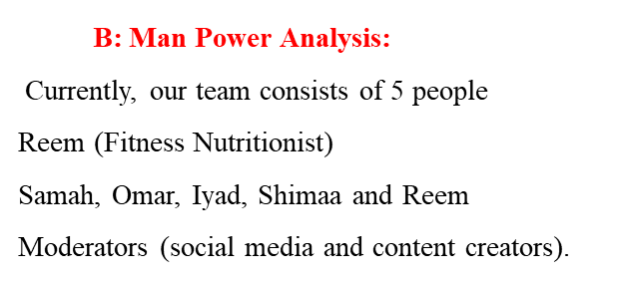

Slide 6
C: Resources Analysis:
Physical: Meal plans, exercise programs, supplement guidance
Digital: Social media presence (Facebook page, ticktock, Instagram), pics, videos.
Human: Content creators (Reem and Shimaa), Moderators (Samah and Reem), Graphic designer (Omar), Media buyer (Omar), Video editor (Eyad).
Financial: Budget for marketing (1250 LE)
D: PEST Analysis:
Political: Health regulations for food and supplements (No effect)
Economic: Life burdens may affect the number of people joining nutrition programs.
Social: Focus on wellness and body positivity, Rise in diseases due to wrong lifestyle.
Technological: Advancement in fitness apps and personalized meal plan platforms.

Slide 7
E: Customer Analysis:
Who: Men and women (11- 55)
Where: Online (Egypt)
When: 8 AM - 10 PM
What: Better life style and good health.
Why: To feel healthy and enjoy life
F: Competitor Analysis:
https://fedubuedu-my.sharepoint.com/:x:/g/personal/shimaa170037_fedu_bu_edu_eg/ETya-OCVQgNJssVTeA-4_TcB43MWEAFOEXMrZVkc4yVy7g?e=BQQGRI
Dr. Ola Mekhemer
Coach Sama
Captain Maged
Aya Anayel
DFN
Sama Fit

Slide 8
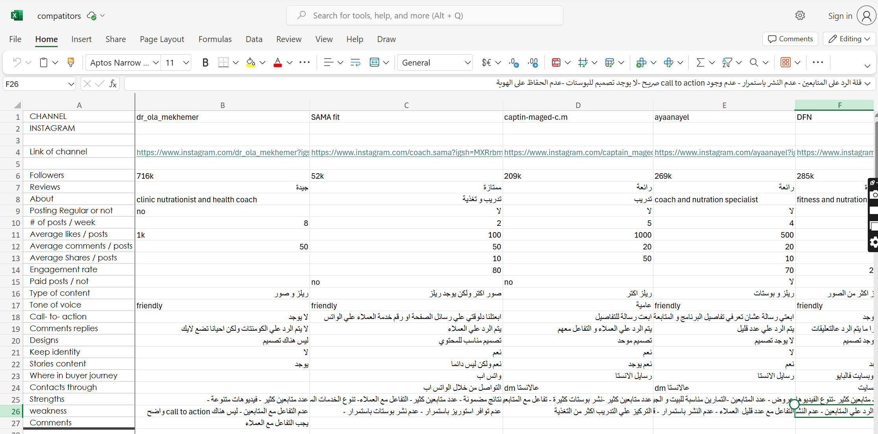

Slide 9
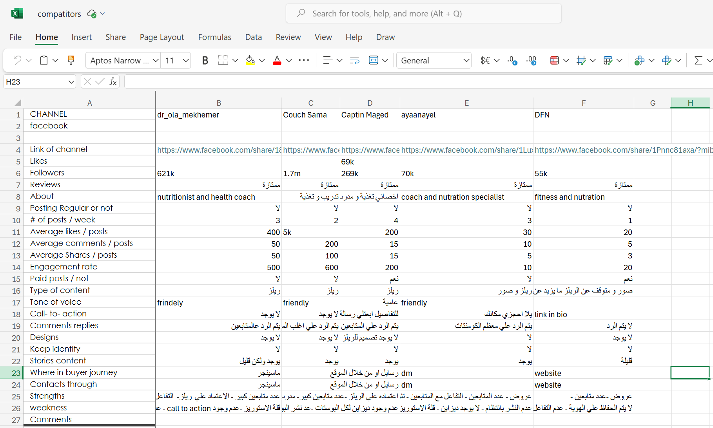

Slide 10
Swot Analysis
Strengths:
Personalization
Injury prevention focus
Addressing emotional eating problems
Focus on allergies to gluten and lactose.
Weaknesses:
Brand awareness on a wide scale.
Having a small team

Slide 11
Swot Analysis
Opportunities:
Growing health awareness.
Using technology in generating more creative ideas in our designs and content to save time and effort.
Threats:
Strong competition
Income problems

Slide 12
2) Objectives:
The 5 Ss
Sell: Increase sales of meal plans, training programs, and consulting services to reach 15000 LE within the next 6 months.
Serve: Improve customer satisfaction through better personalized plans and addressing emotional eating or food sensitivity.
Speak: Engage with the audience on social media platforms by increasing interaction by 30%.
Save: Reduce costs by offering online consultation instead of in-person services for wider reach.
Sizzle: Build a strong brand presence by sharing success stories and providing valuable, actionable content.

Slide 13
3) Strategy:
A) Segmentation:
Segment | Service
Men (20-35) (36-55) | Seeking losing weight
2. Men (20-35) (36-55) | Seeking gaining weight
3. Men (20-35) (36-55) | Seeking getting fit
4. Women (20-35) (36-55) | Seeking losing weight
5. Women (20-35) (36-55) | Seeking gaining weight
6. Woman (20-35) (36-55) | Seeking getting fit
7. Teens (11-17) | Suffering from food sickness (allergies, psychological)
8. Teens (11-17) | Seeking losing weight
9. Teens (11-17) | Seeking gaining weight
10. Teens (11-17) | Seeking making shape

Slide 14
Targeting:
Men: Seeking to Lose Weight:
Targeting Strategy: Focus on fitness programs, diet plans, and weight loss supplements. Highlight success stories and testimonials from men in this age group.
Men : Seeking to Gain Weight:
Targeting Strategy: Promote muscle-building supplements, high-protein diets, and strength training programs.
Men : Seeking to Get Fit:
Targeting Strategy: Offer comprehensive fitness plans that include both cardio and strength training. Emphasize overall health and wellness.
Women : Seeking to Lose Weight:
Targeting Strategy: Focus on weight loss programs, healthy meal plans, and fitness exercises tailored for women.

Slide 15
Targeting:
Women : Seeking to Gain Weight:
Targeting Strategy: Promote balanced diets, strength training programs, and nutritional supplements.
Women : Seeking to Get Fit:
Targeting Strategy: Offer fitness exercises and balanced diets.
Teens : Suffering from Food Sickness (Allergies, Psychological):
Targeting Strategy: Provide specialized diet plans and counseling services.
Teens : Seeking to Lose Weight:
Targeting Strategy: Promote healthy eating habits, fitness exercises.

Slide 16
Targeting:
Teens : Seeking to Gain Weight:
Targeting Strategy: Offer nutritional guidance and strength training programs.
Teens : Seeking to Make Shape:
Targeting Strategy: Provide fitness programs focused on body shaping, nutritional advice, and motivational content.

Slide 17

C) Positioning:
"At Train and Nourish, we empower men, women, and teens to achieve their fitness goals through personalized nutrition and training systems. Whether you're aiming to lose weight, gain strength, or simply get fit, our expert guidance caters to every stage of your journey, including managing food allergies and psychological challenges. With a focus on holistic well-being, we ensure sustainable results for all ages."

Slide 18
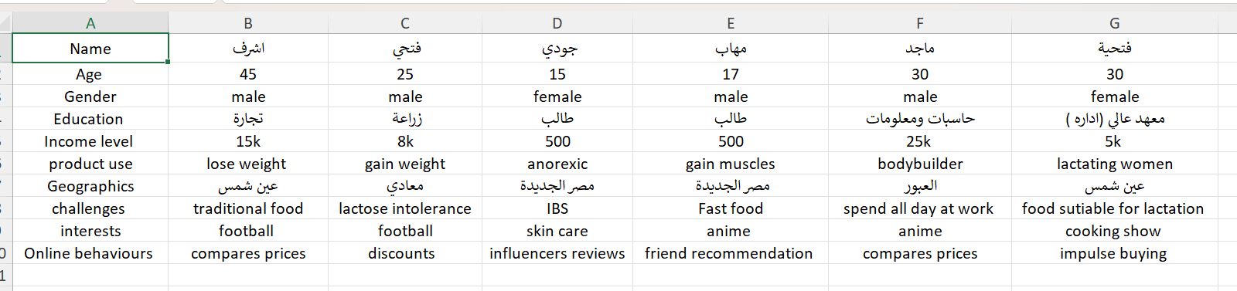
D) Buyer Persona:

Slide 19
F) Competitive Advantage:
It is our unique selling point that we offer:
Focusing on programs to avoid emotional eating.
Focusing on personalized Teen’s nutrition programs.
Linking the nutrition programs with the fitness plans.
Focusing on programs that helps to food allergies.

Slide 20
4) Tactics:
Marketing Mix (4 Ps):
Product: Meal plans, training programs, supplements guidance, personalized consultations
Price: Suitable pricing for basic plans, premium plans, and specialized services like food allergy consultations.
Place: Social media (Facebook), Instagram (Targeting People in Egypt).
Promotion: Online campaigns, engaging posts and videos
B) Channels Used:
Facebook
Instagram
Tick Tock
Sponsored ads

Slide 21
Tactics:
c) Frequency of Posting:
2 posts daily that are turned into a story
1-2 videos per week
1 reel every two days.
D) Time of Posting:
Everyday
E) Types of Content Used:
posts
videos
reels
stories
F) Tone of Voice:
Friendly and Supportive.

Slide 22
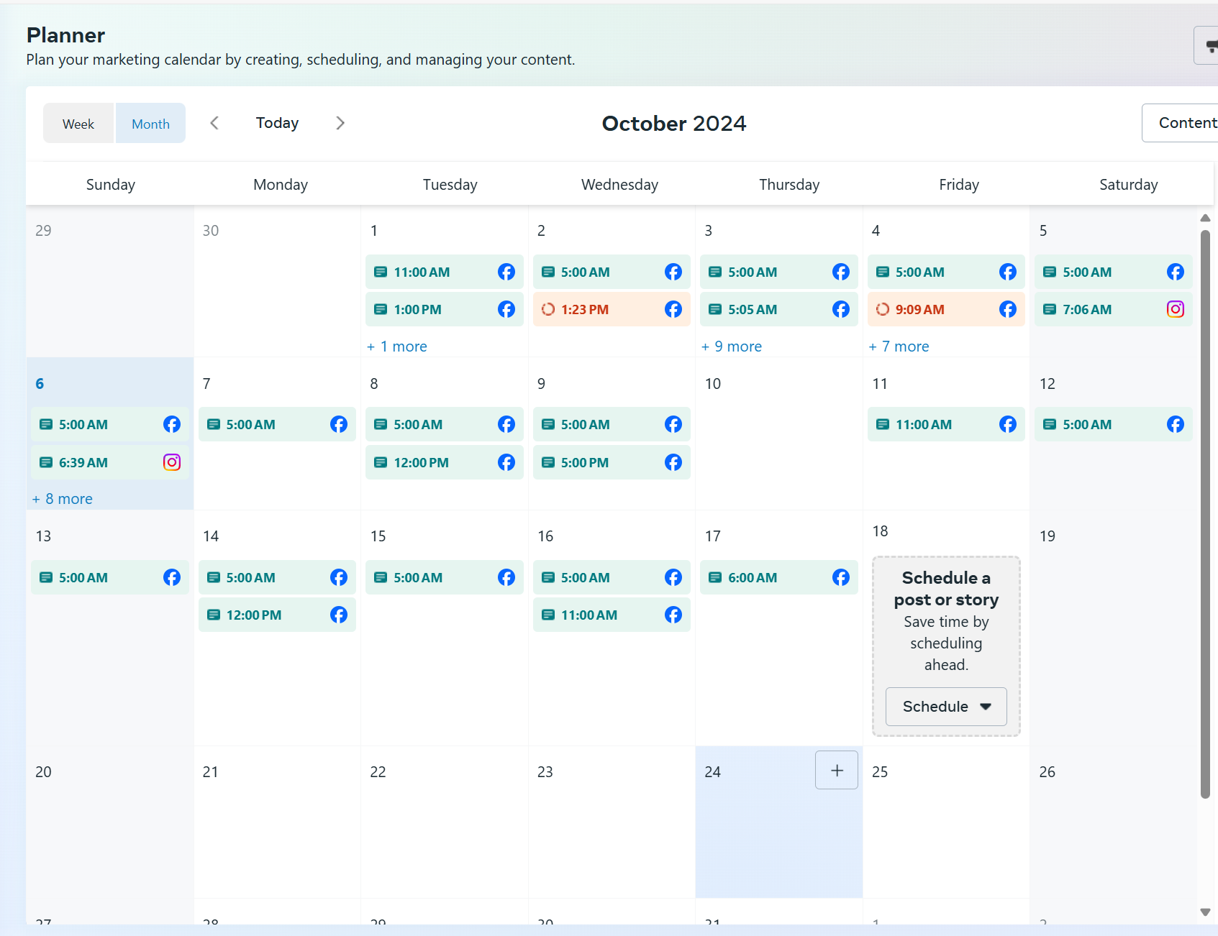
Content Calendar:

Slide 23
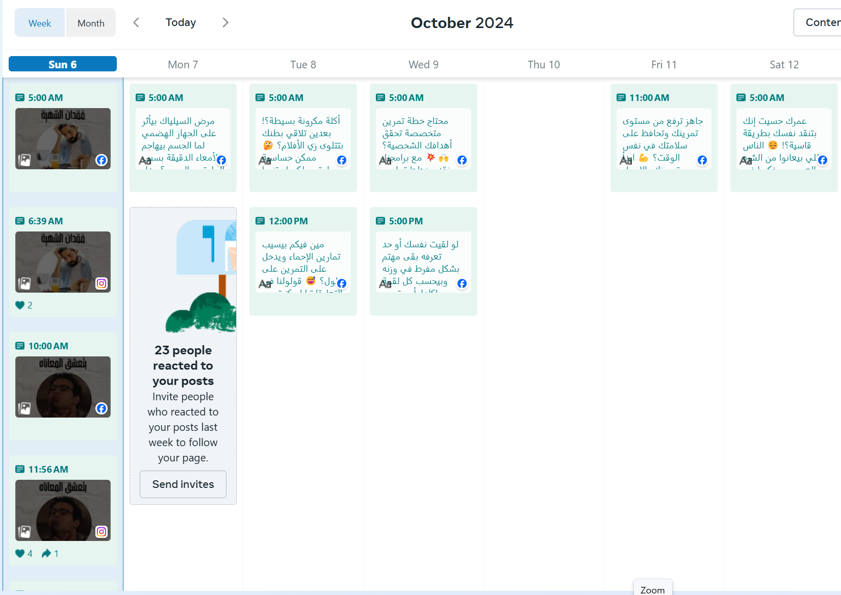
Our posting started on 28th September to 17th October.
We created the content calendar using the Facebook planner.

Slide 24
Item | Who | When | How | Cost
Product Analysis | Reem | Before starting the campaign | By analyzing the market, the customer needs, the competitors
Man power Analysis | Reem
Resources Analysis | Samah
PEST Analysis | Samah
Competitor Analysis | Shimaa
Swot Analysis | Eyad
5 Cs | Omar
Segmentation | Reem
Targeting | Samah
Positioning | Samah
Buyer persona | Reem
Competitive Advantage | Samah
Tactics | Omar, Eyad, Shimaa
Content calendar | Reem
5) Actions:

Slide 25
Item | Who | When | How | Cost
Content Creator | Reem | Everyday since 28 Sept to 17 Oct 10 October | On Social media platforms | 1250 LE
Content Creator (Sponsored ads) | Samah
Designer | Omar
Video creator | Shimaa
Video editor | Eyad
Facebook Moderators | Reem, Samah
Instagram Moderators | Reem, Eyad
Tick Tock moderators | Reem, Shimaa
Media Buyer | Omar
Control observations | All the team
Team Coordination | Samah
Files and presentations preparations | Samah
5) Actions:

Slide 26
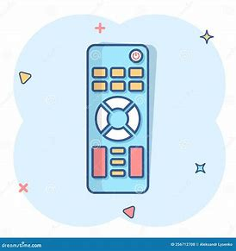
6) Control
The following points will be measured:
Sales
Impressions
CTR
Reach
Messages

Slide 27
Our Canvas Model

Slide 28
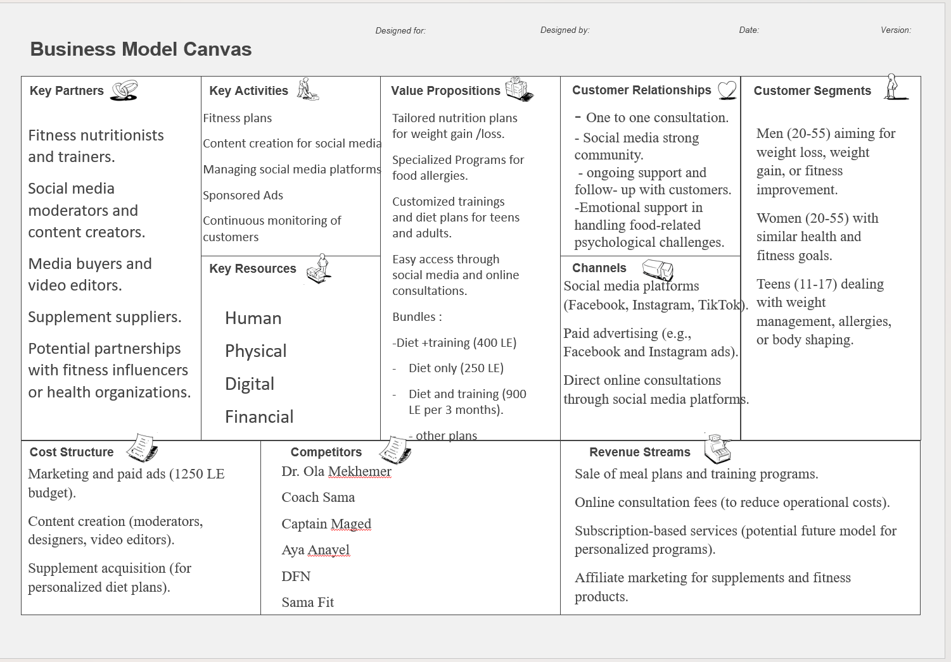

Slide 29
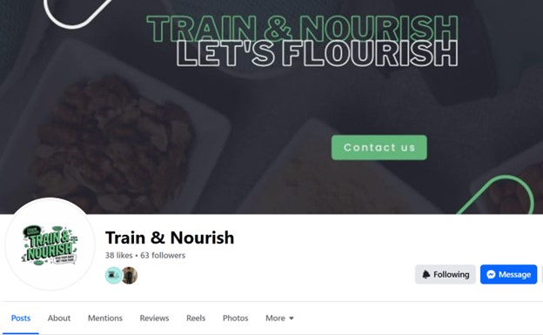
Campaign Overview
Train &Nourish

Slide 30
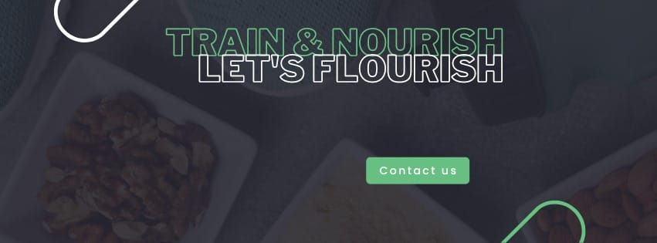

Our Logo and Slogan
Train & Nourish
Let’s Flourish

Slide 31
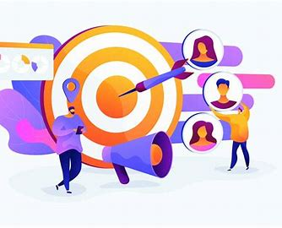
Our goal is :
Brand Awareness
Engagement
Lead
Sales
Content
40% Engagement
40% Educational
20% Sales
Our Strategy:
Social Media Content through (Facebook, Instagram , TickTock

Slide 32



Platforms Links:
https://www.facebook.com/share/35c8rR6jFmvXizp1/?mibextid=qi2Omg
https://www.instagram.com/train_and_nourish?igsh=MTlvbmN3YTQ5amc4cA==
Coach Reem (@train_nourish) | TikTok

Slide 33
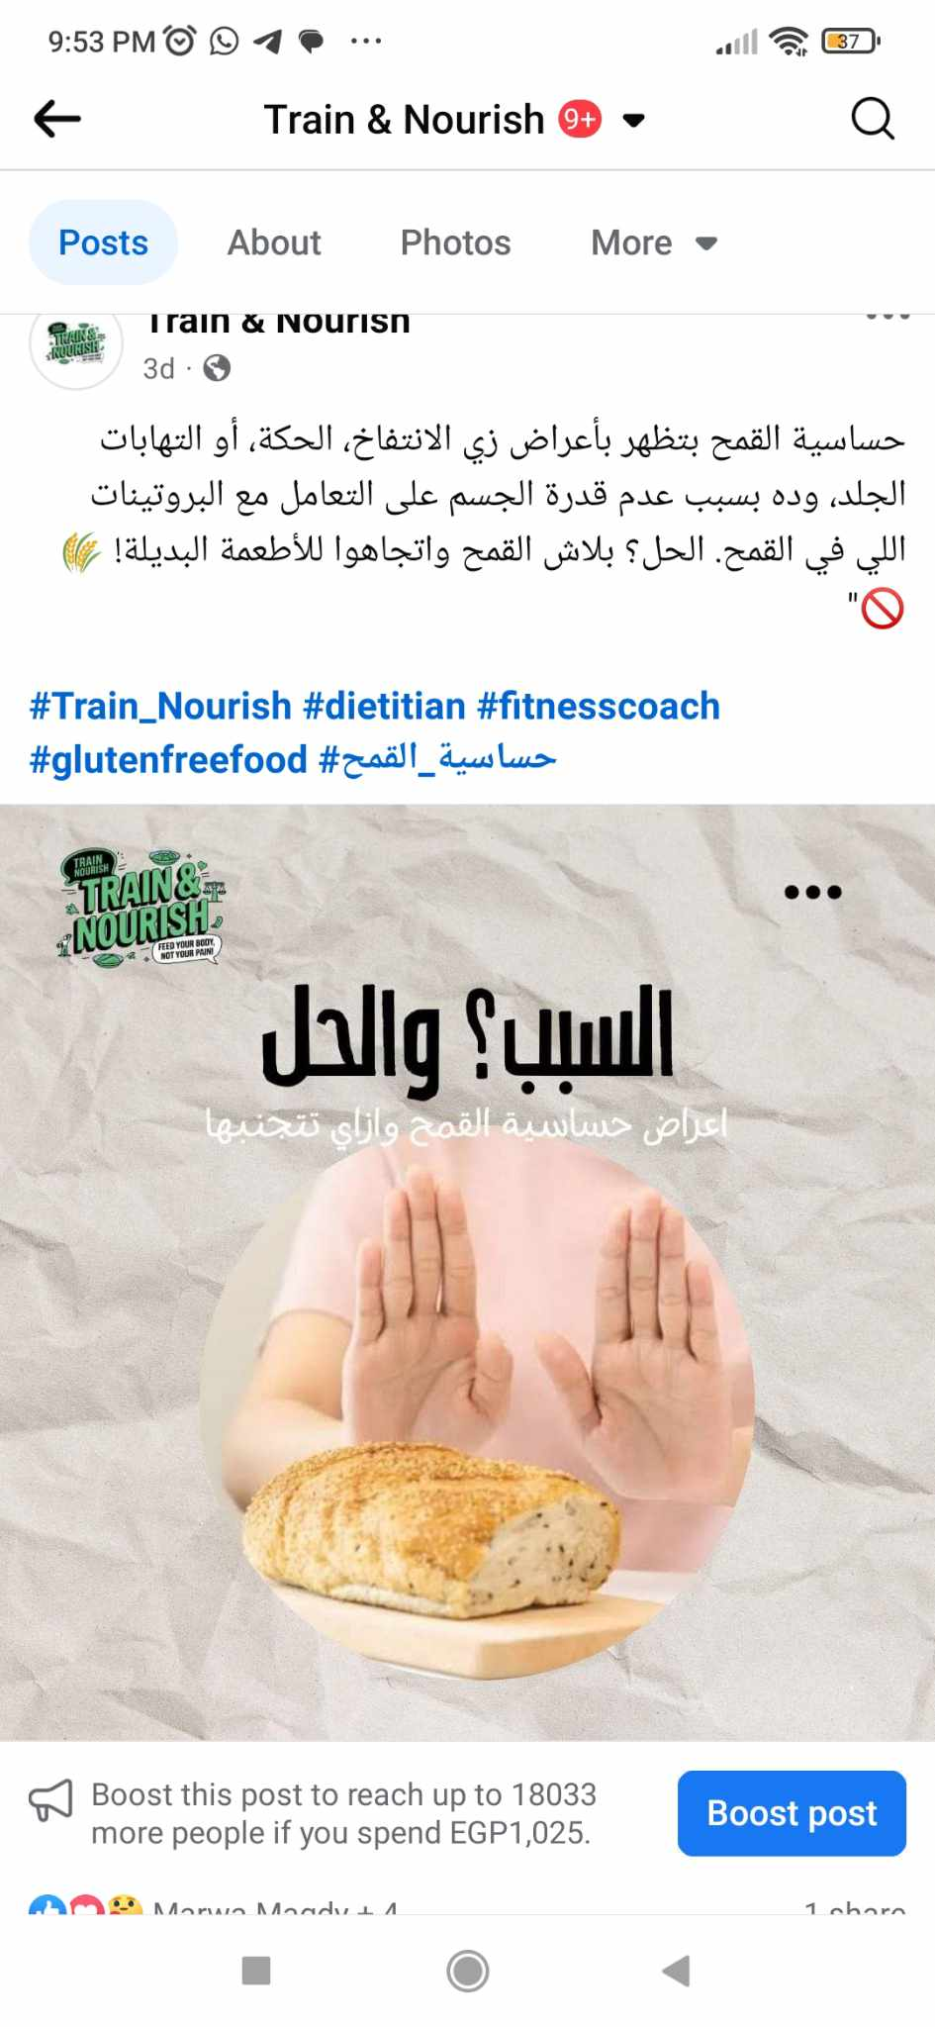
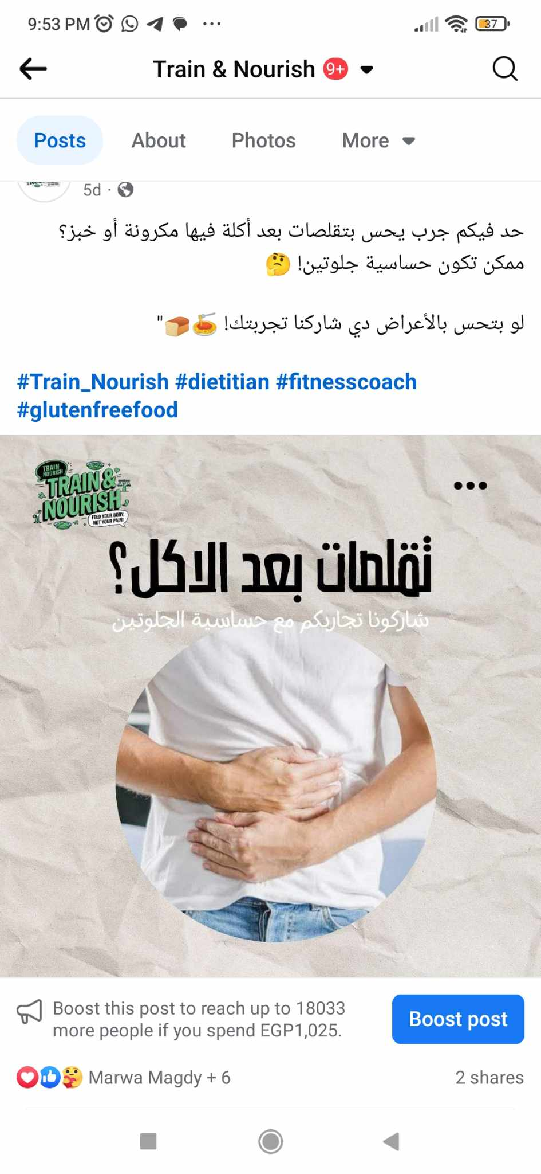


Slide 34
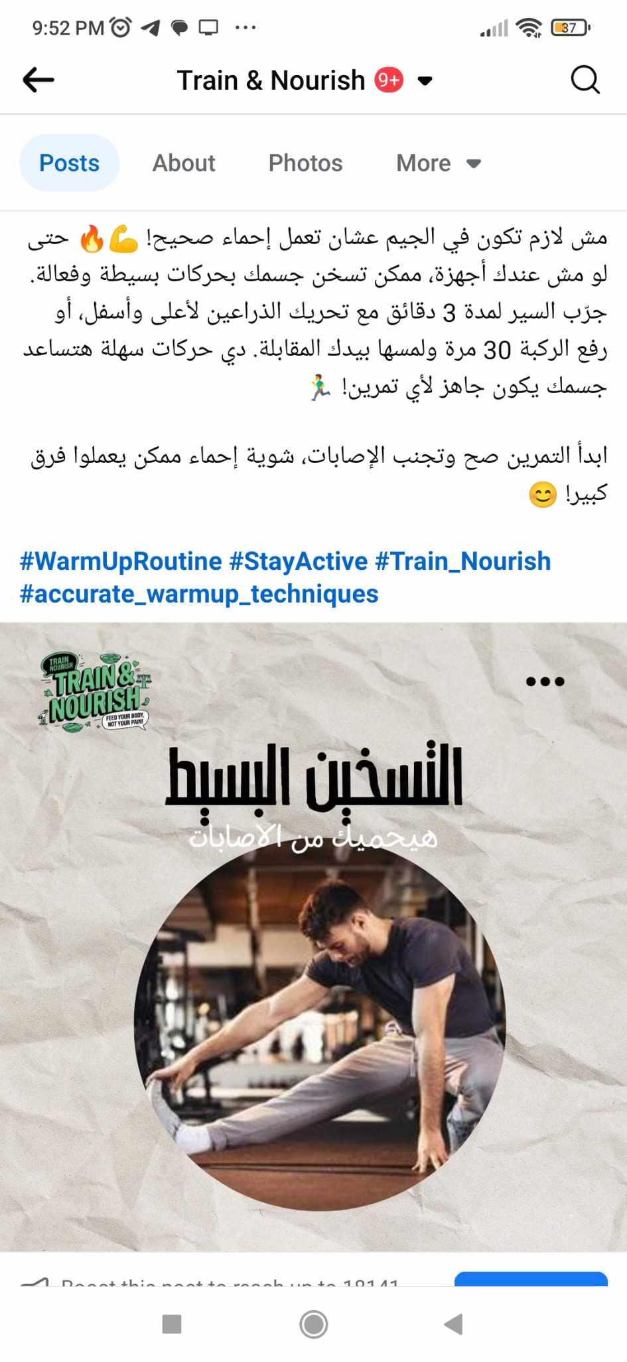
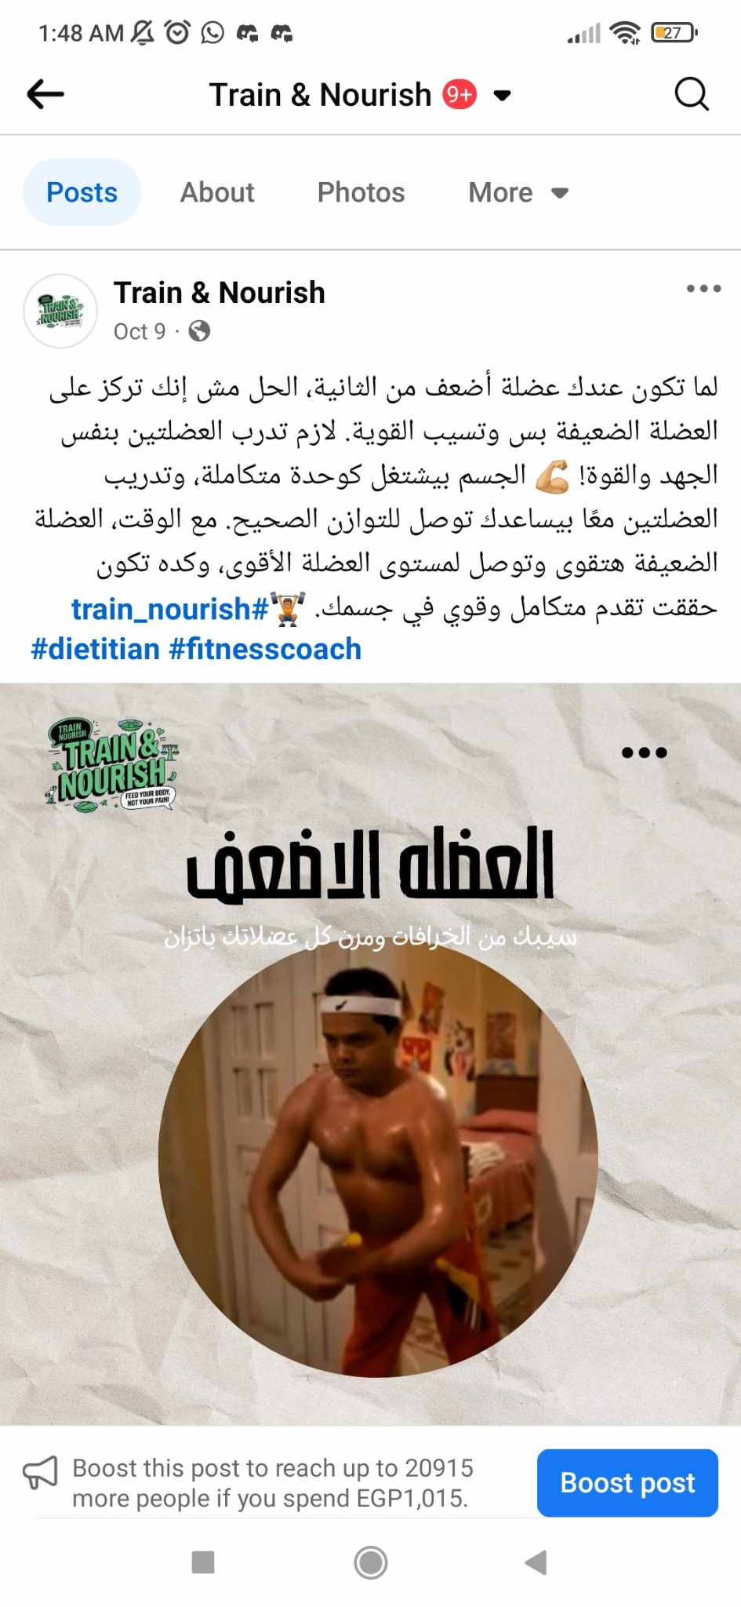
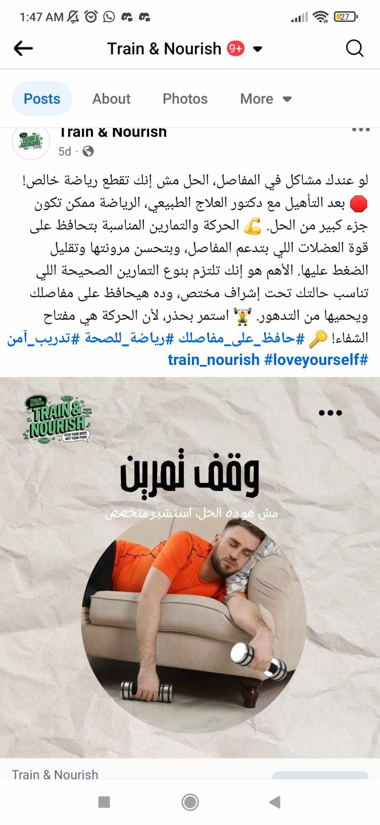

Slide 35
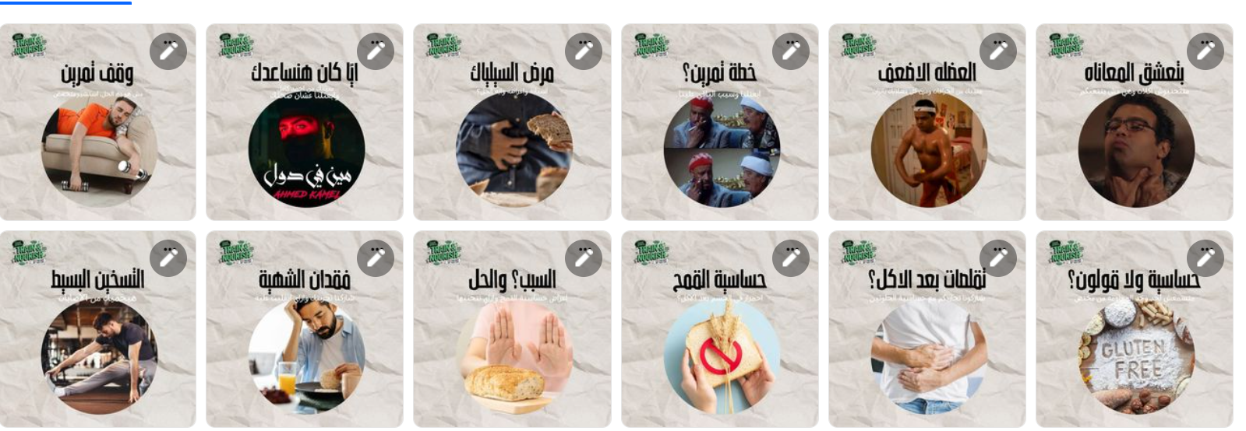

Slide 36
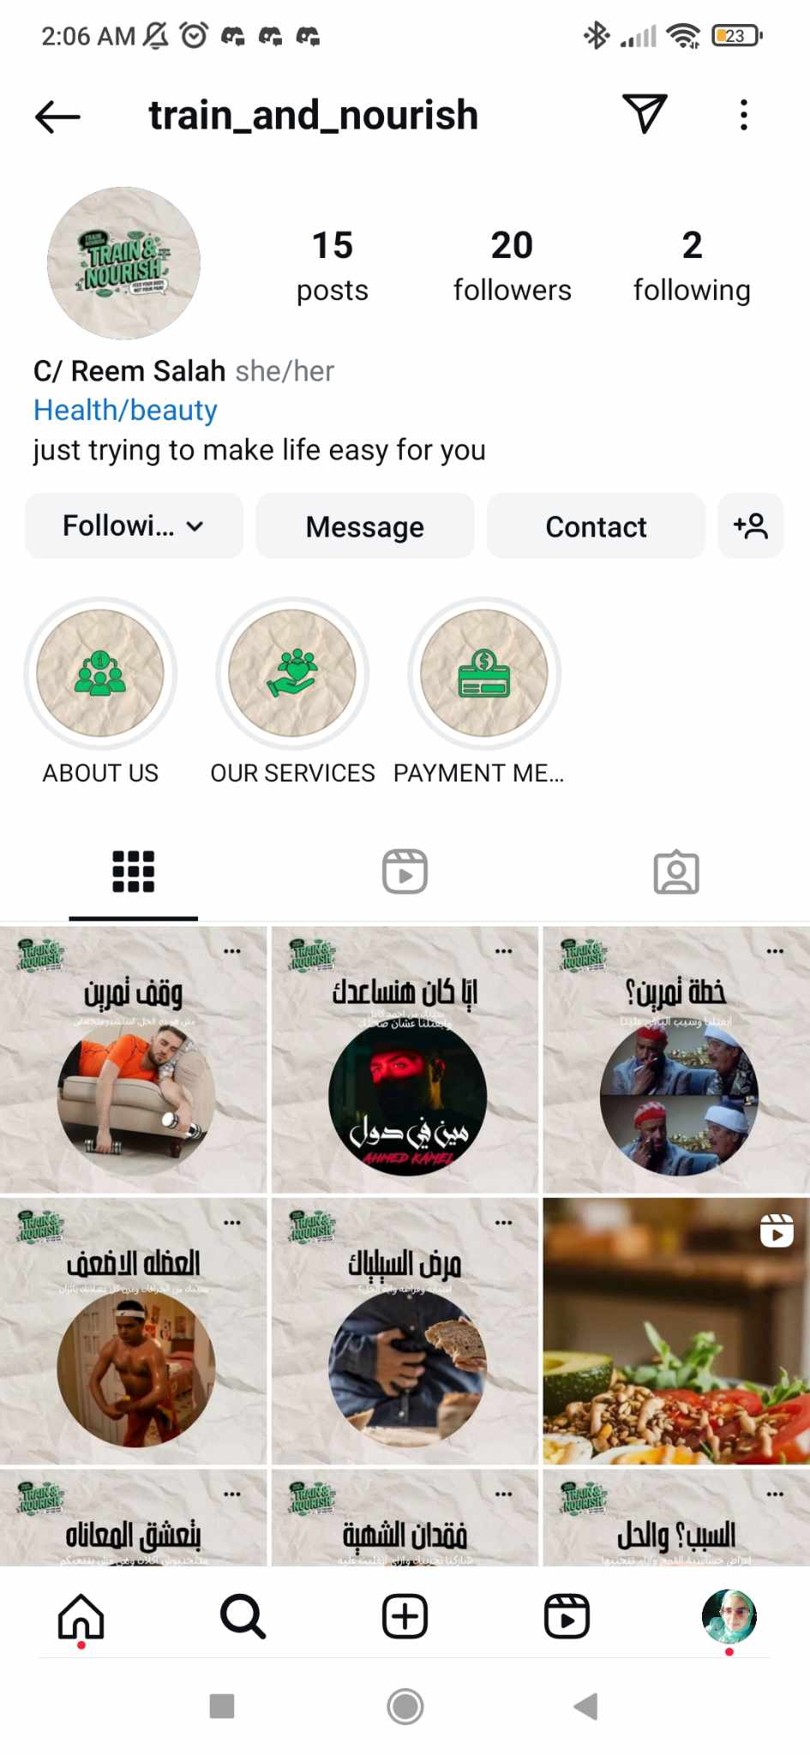
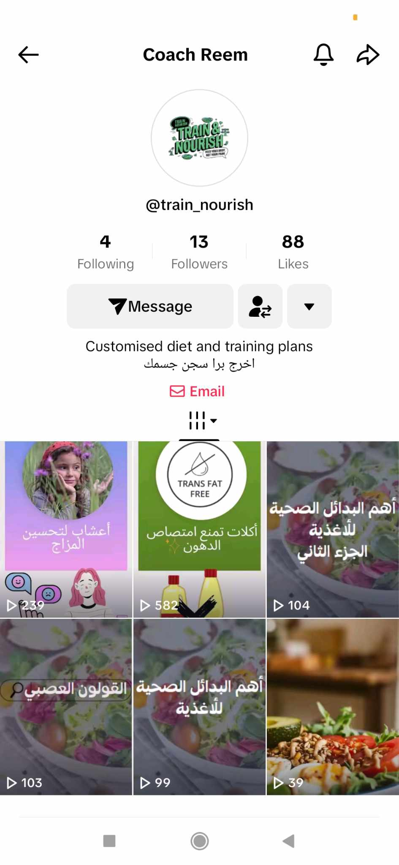
Instagram
& TickTock Screens

Slide 37
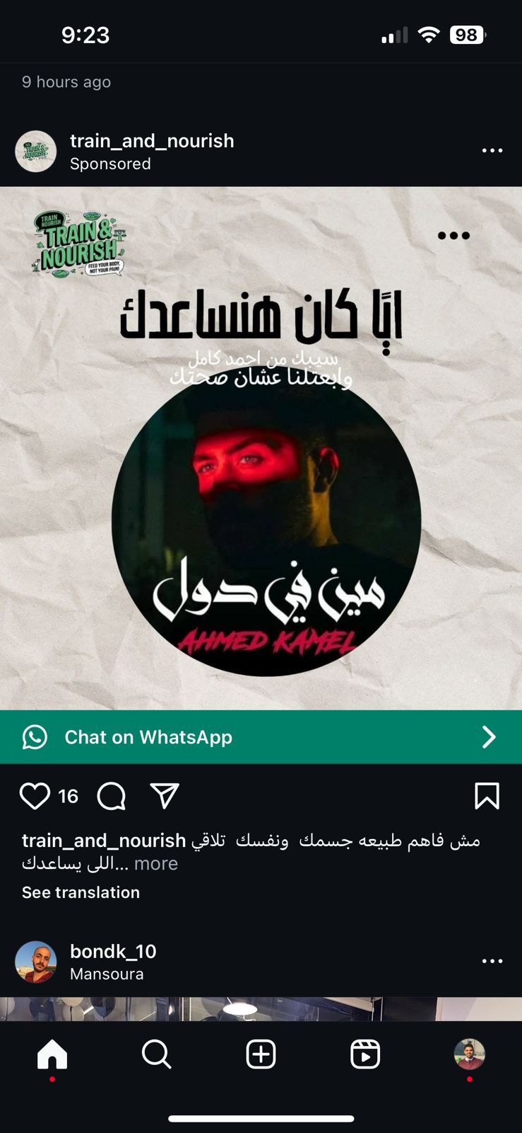
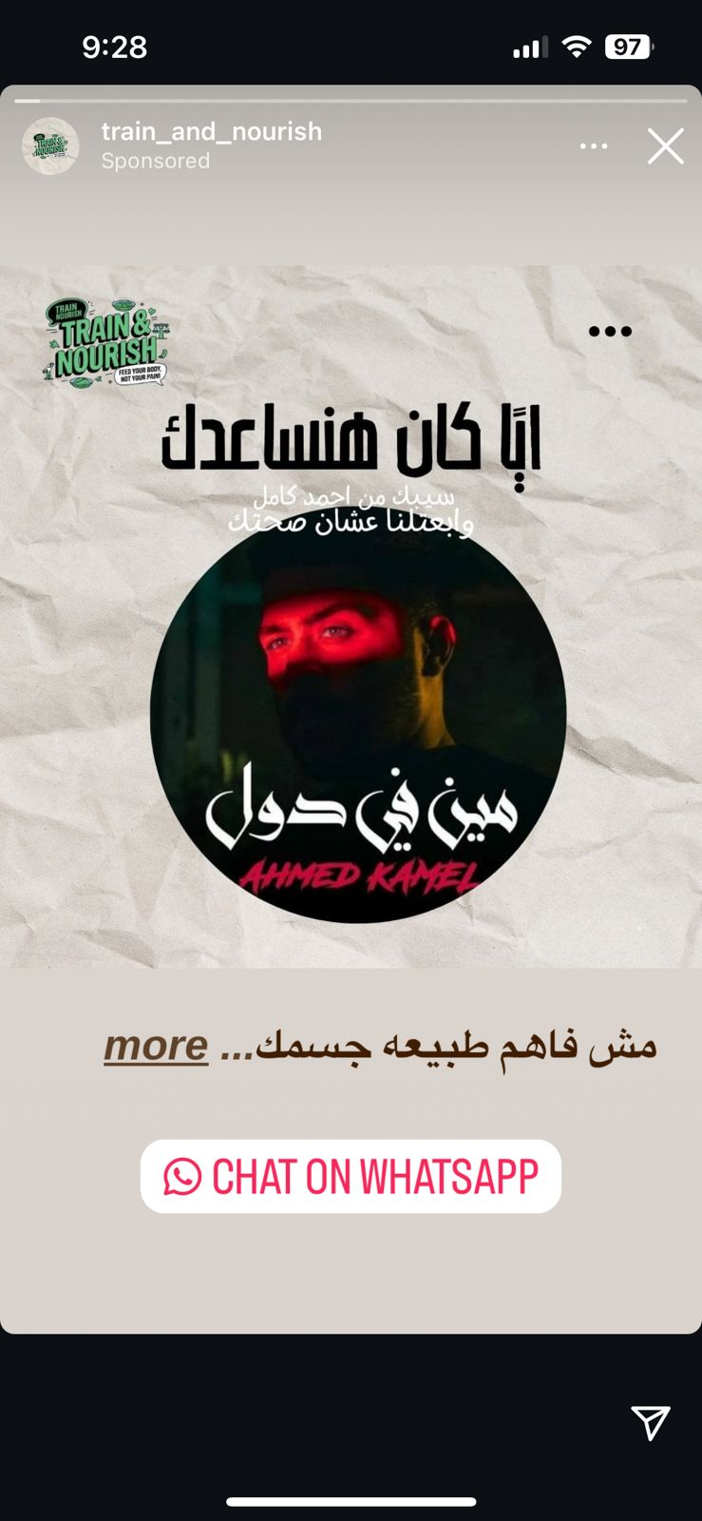
Sponsored Ads :
1. Paid Post
2. Paid video

Slide 38
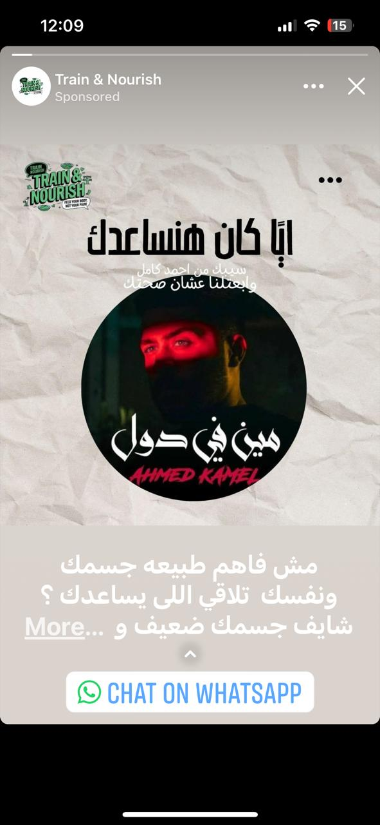
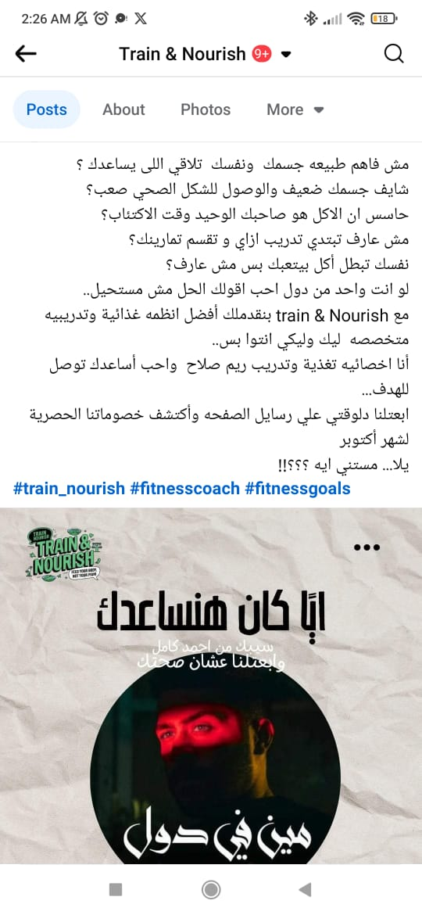
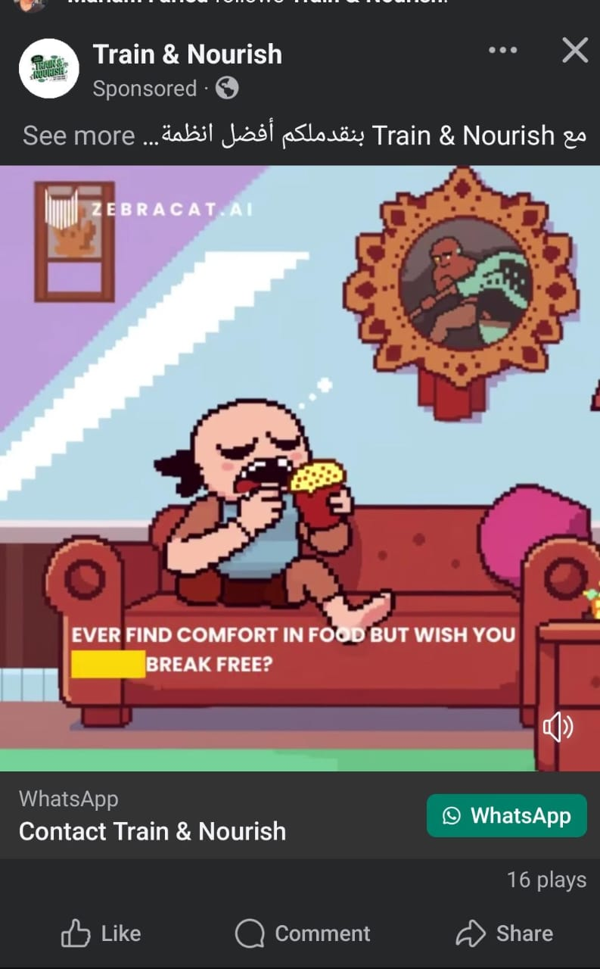

Slide 39
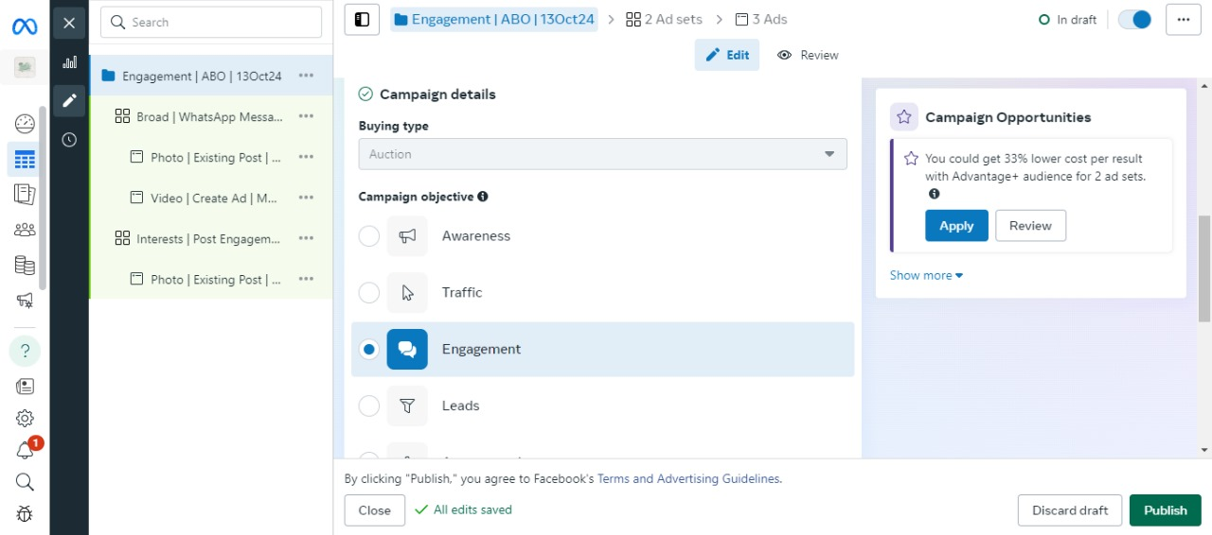
Campaign
Screens

Slide 40
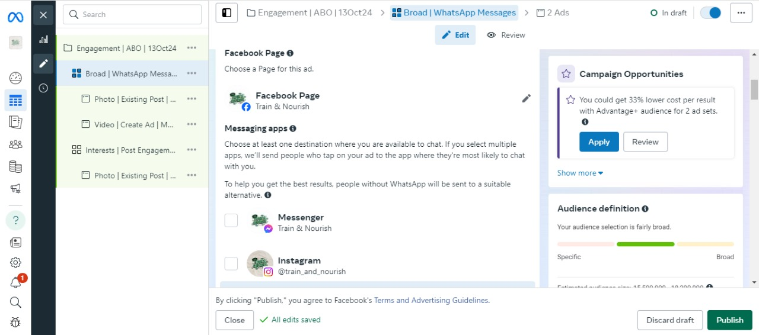

Slide 41
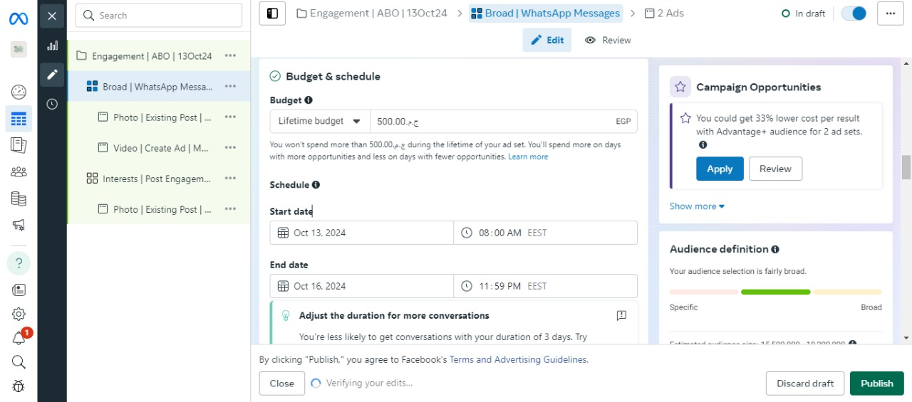

Slide 42
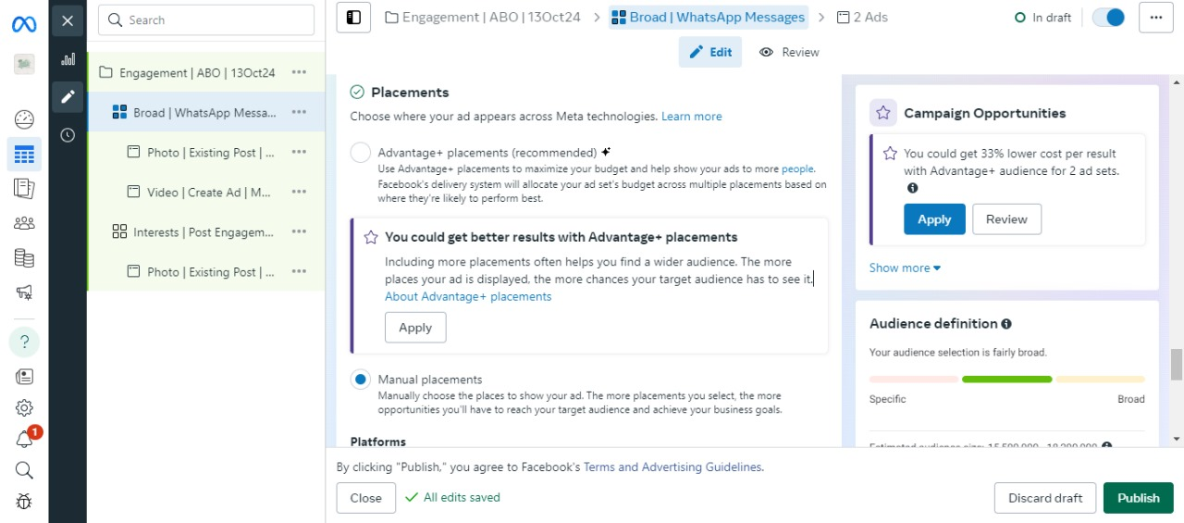

Slide 43
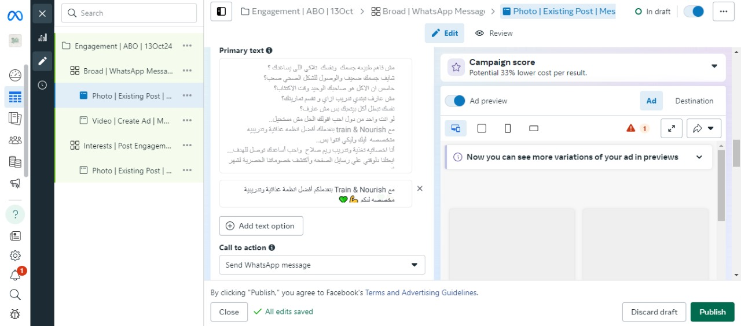

Slide 44
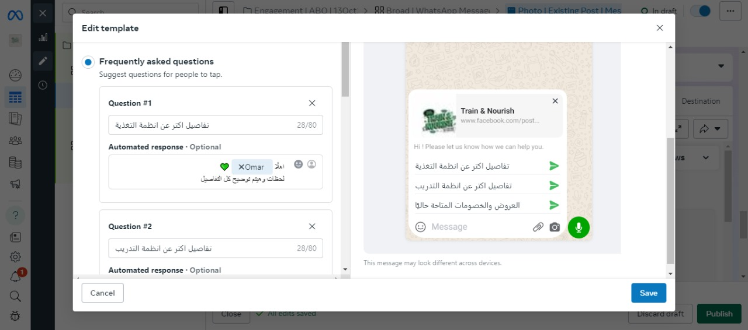

Slide 45
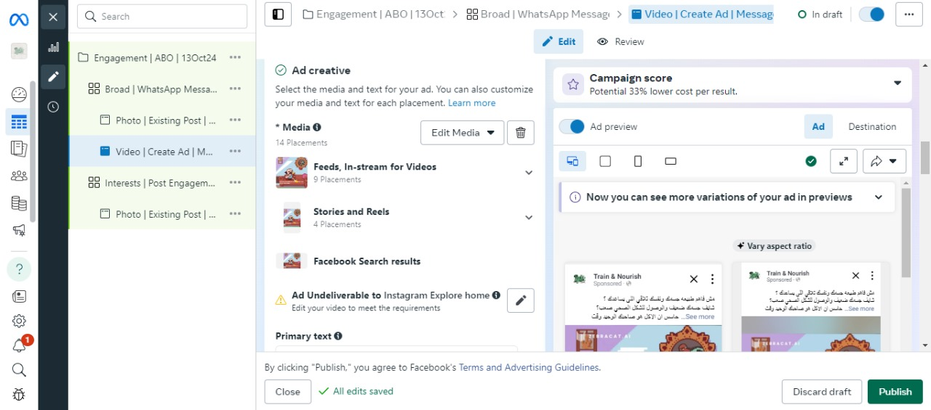

Slide 46
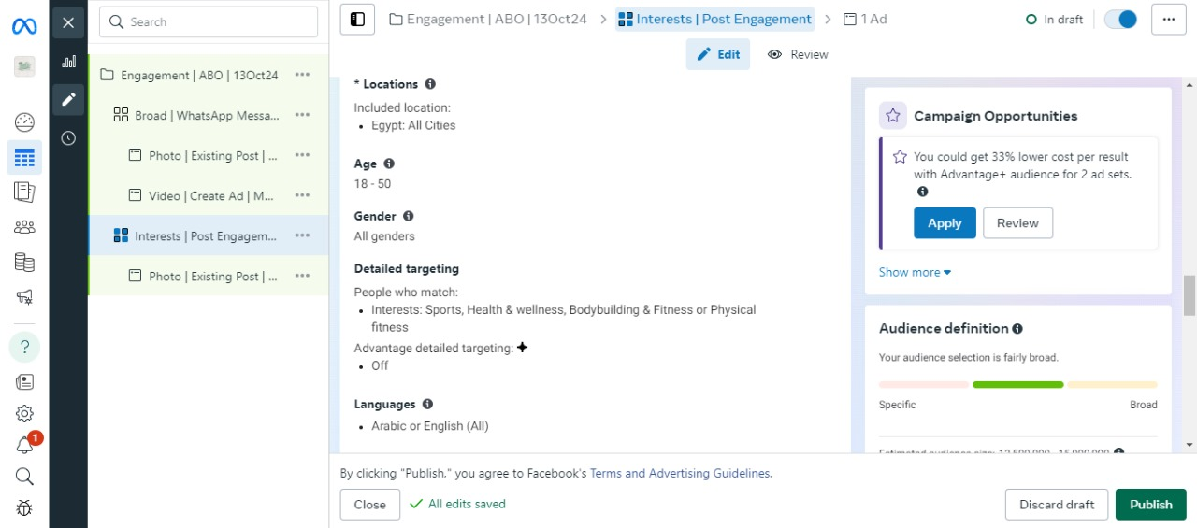

Slide 47
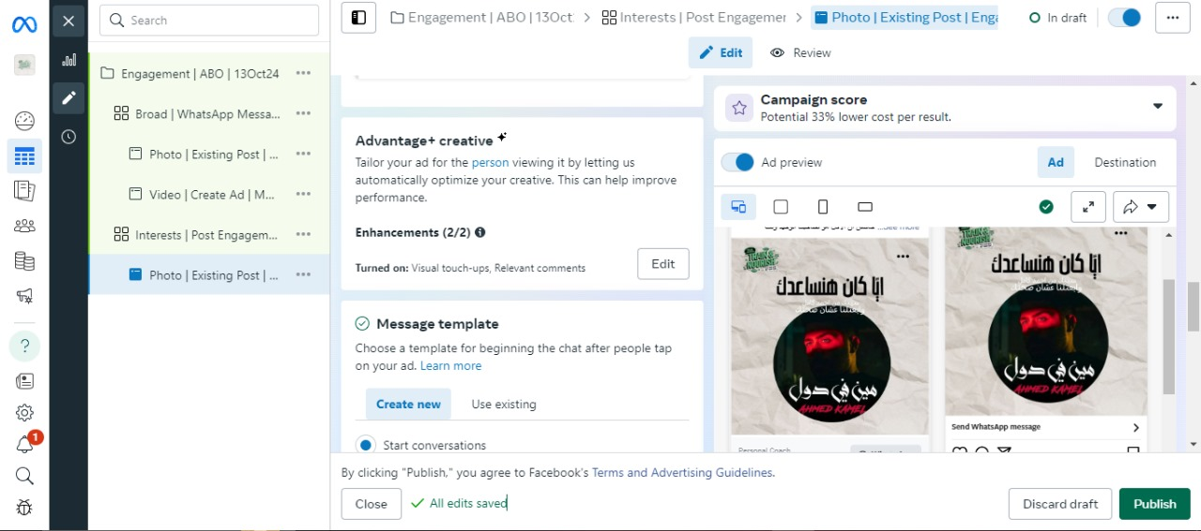

Slide 48
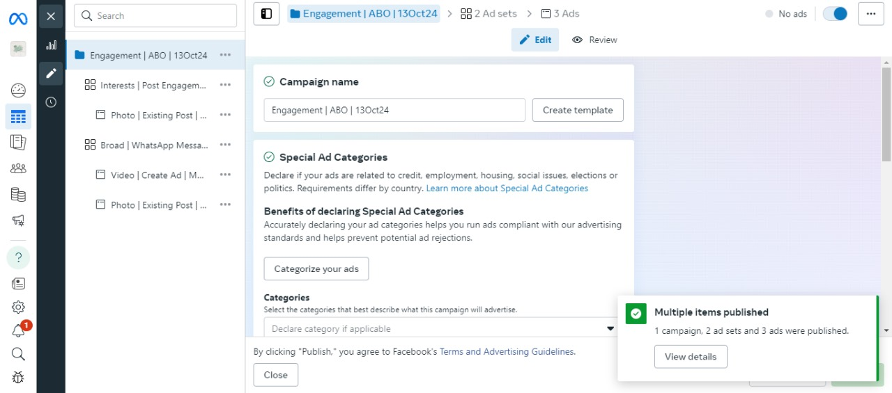

Slide 49
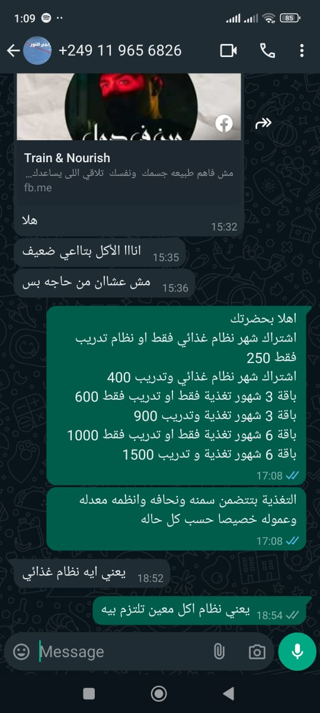
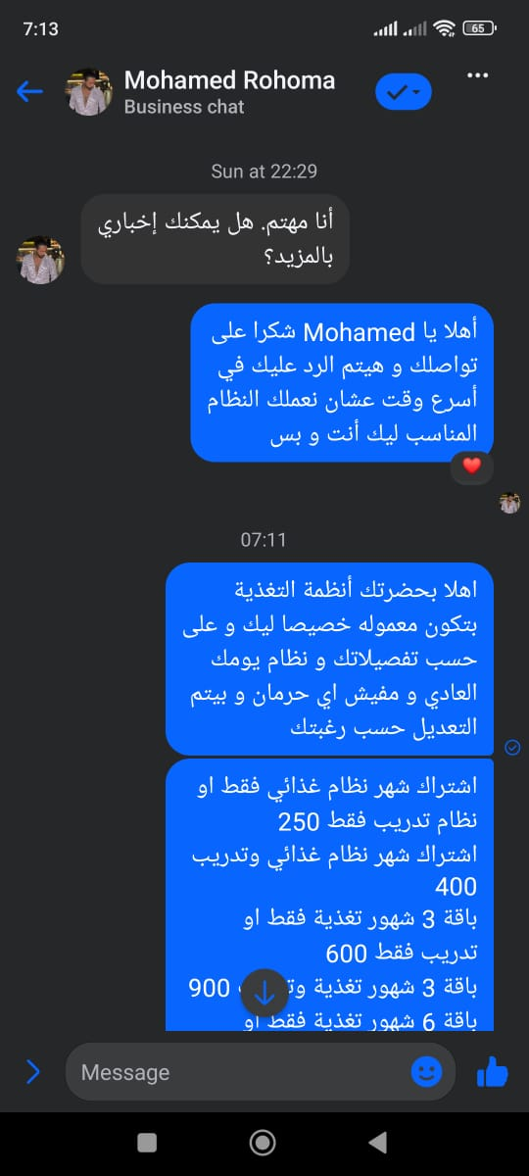
Customers’
Responses:

Slide 50
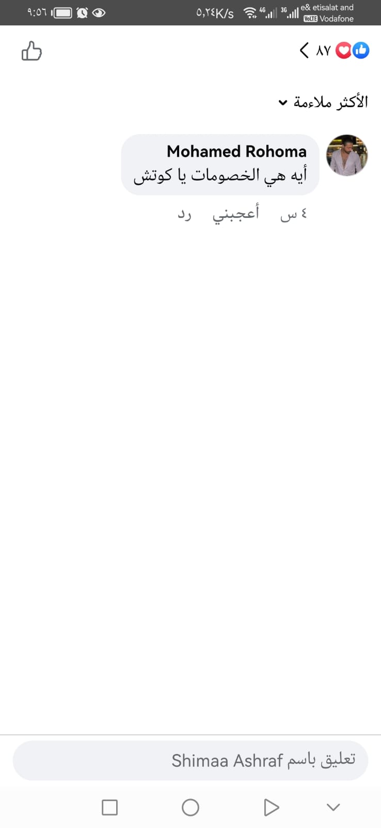
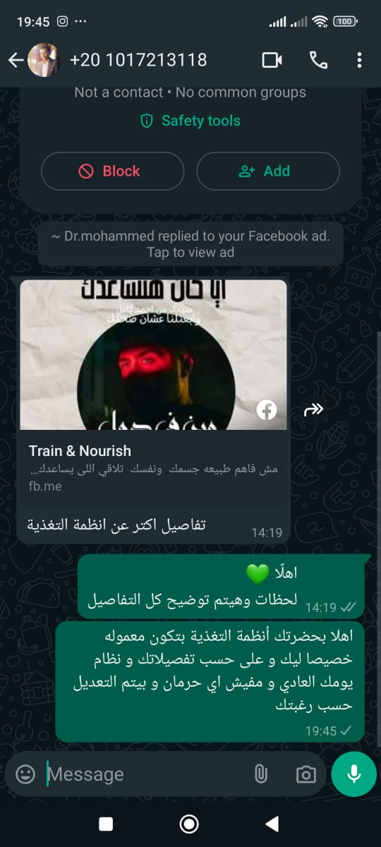
Customers’
Responses:

Slide 51
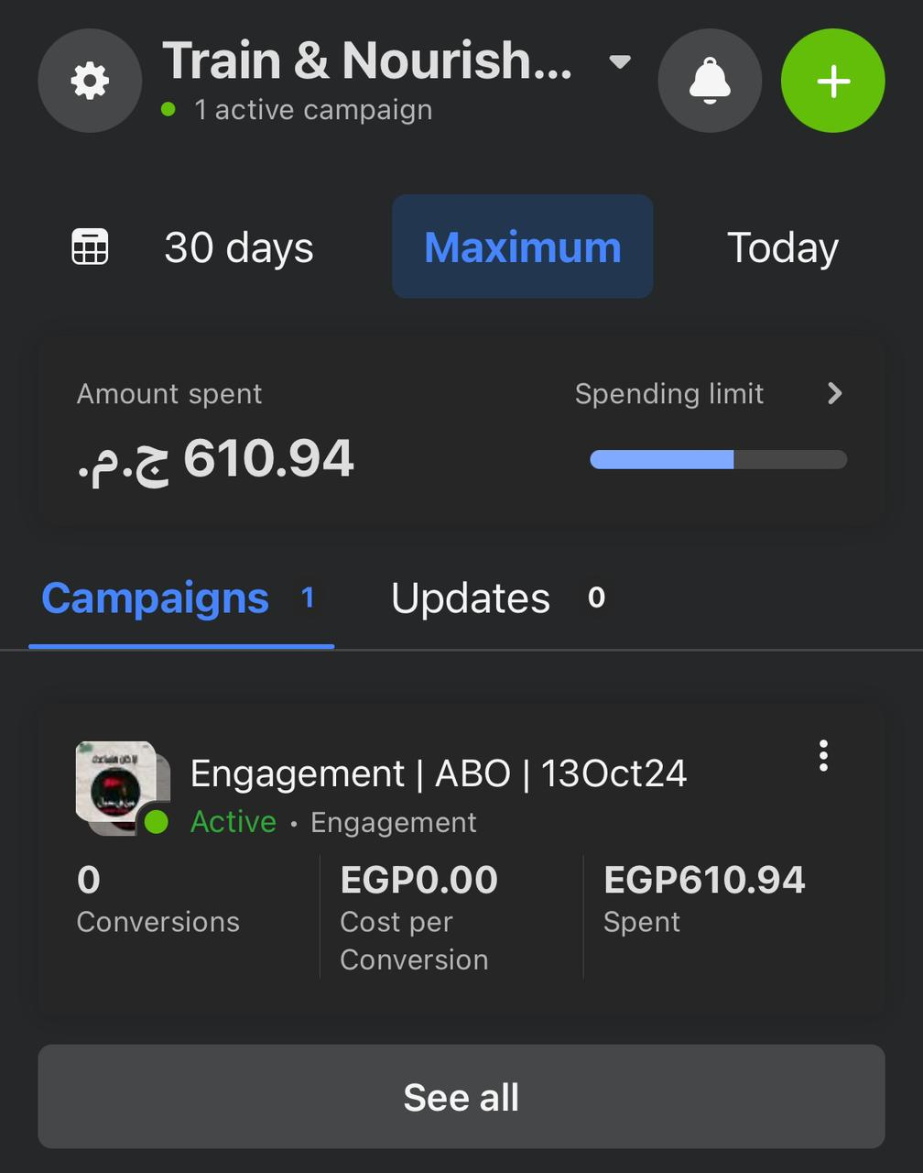
Results:

Slide 52
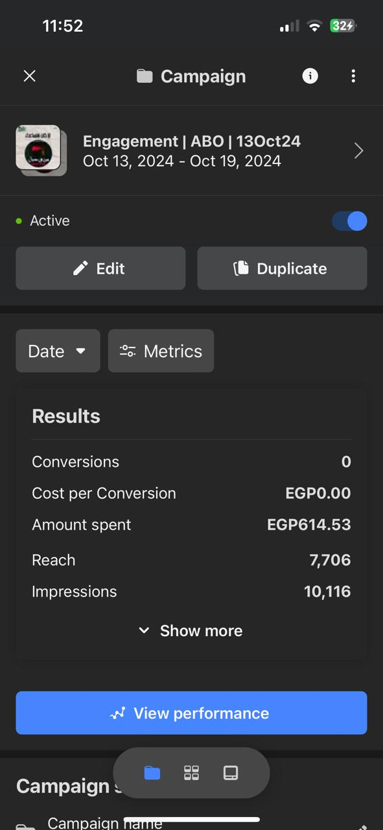
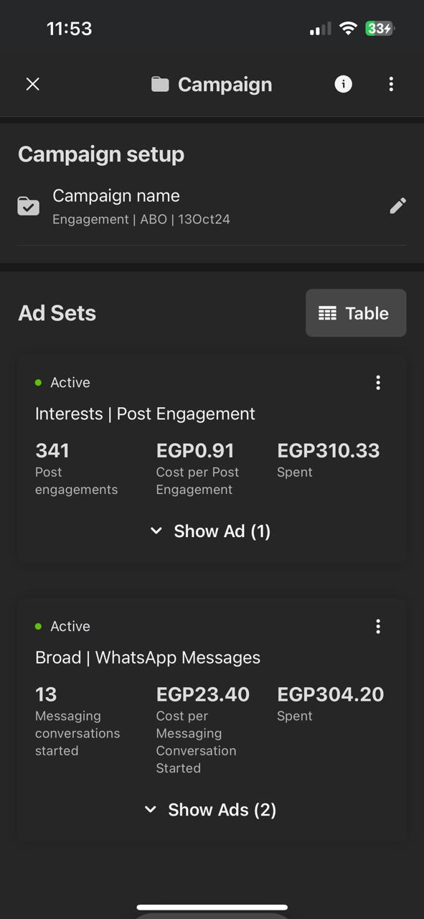
Results:

Slide 53
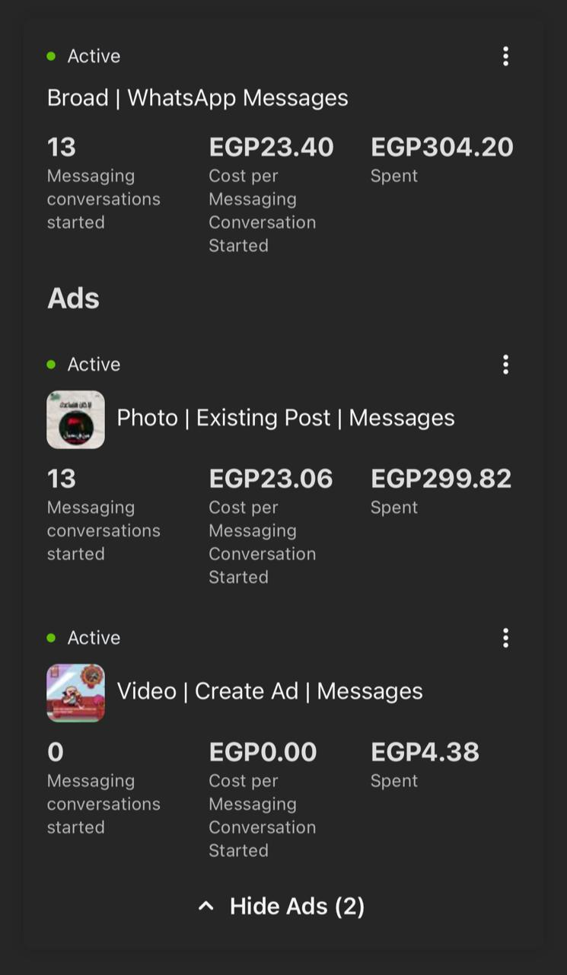
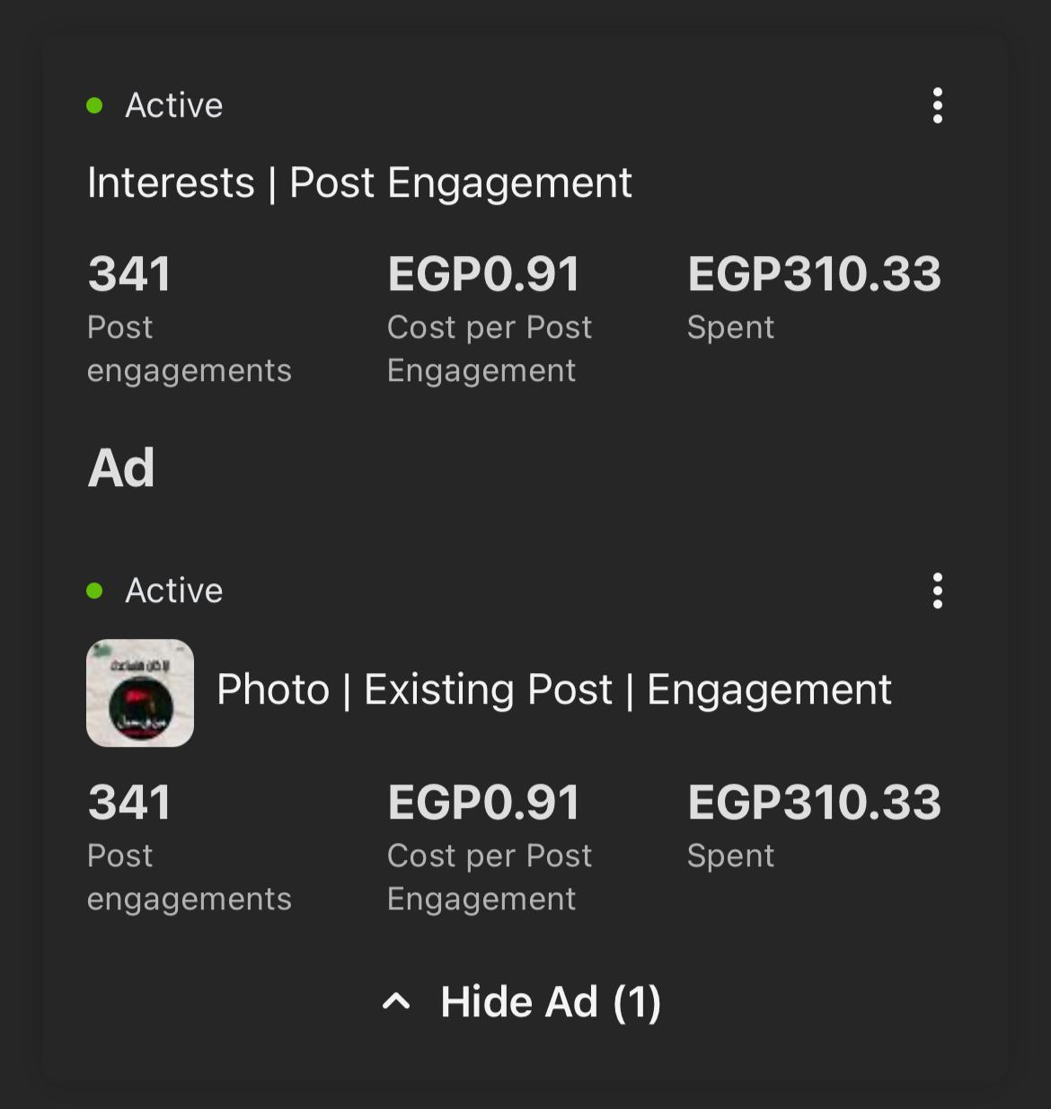
Results:

Slide 54
Observations:
Photo Ads (Existing Post):
Cost per messaging conversation is slightly lower at EGP 23.06, with a total of 13 conversations.
Around EGP 299.82 spent.
WhatsApp Messaging Ads:
- Cost per messaging conversation is around EGP 23.40.
- 13 conversations have started, with about EGP 304.20 spent.
Engagement Ads:
They are relatively cheap at EGP 0.91 per engagement.
Achieved 341 engagements for EGP 310.33.
Reach and impressions seem to be good, with the most recent campaign reaching 7,706 people with 10,116 impressions, but no conversions yet.
Video Ads:
Spent EGP 4.38, but no messaging conversations have been started yet.

Slide 55
Recommendations:
Refine Target Audience:
Narrow audience based on fitness, nutrition, or wellness-related behaviors and interests.
Improve Video Ads:
Test shorter videos with clear call-to-action (CTA) early on.
Add captions or text overlays to increase engagement.
Retarget Engagements:
Retarget those who engaged with ads but didn’t convert.
Test New Creatives and Copy:
Experiment with different visuals and messaging.
Use testimonials or success stories to build trust.
Reallocate Budget:
Shift some budget from video ads to better-performing photo ads or engagement campaigns.

Slide 56
Thank you

